Slide 1
Stock Market Prediction
Overview
Business Understanding
Data Understanding
Data Preparation
Modeling
Evaluation

Slide 2
Overview
Accurate prediction of stock market asset is a significant and challenging task due to complicated nature of the financial stock markets. Considering the increasing availability and affordability of powerful computational engines, deep learning methods of prediction have proved its efficiency in finance.

Slide 3
Business Understanding
My capstone project is Stock market Prediction. I’m going to build a time series regression model using NN or other advanced techniques to predict the stock market. Stock market prediction aims to determine the future movement of the stock value of a financial exchange. My project is helpful for Stock investors and investment banks to have a better understanding in developing economical Strategy and in making financial decisions.

Slide 4
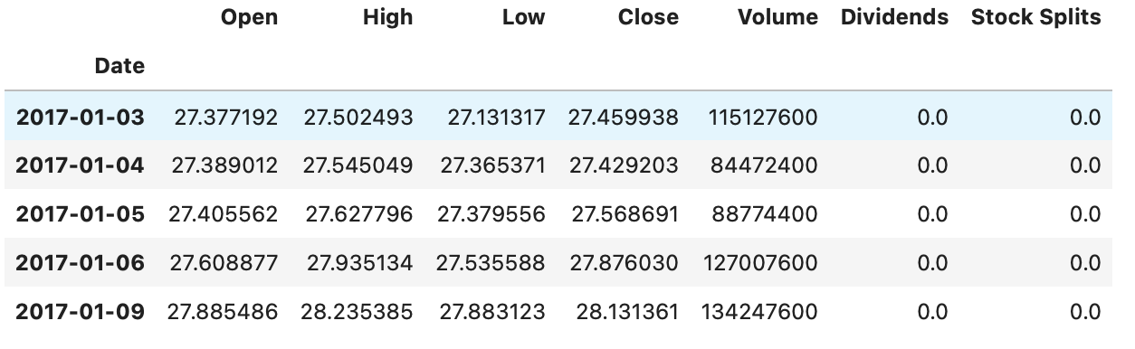
Data Understanding
IEX API and Yahoo Finance

Slide 5
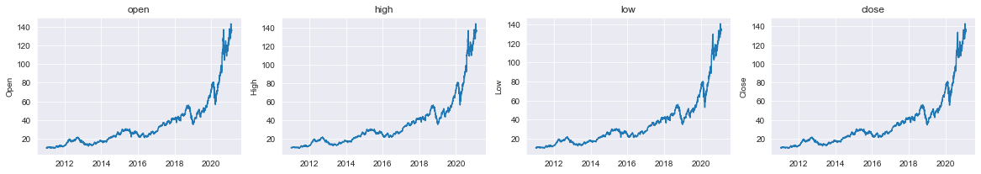
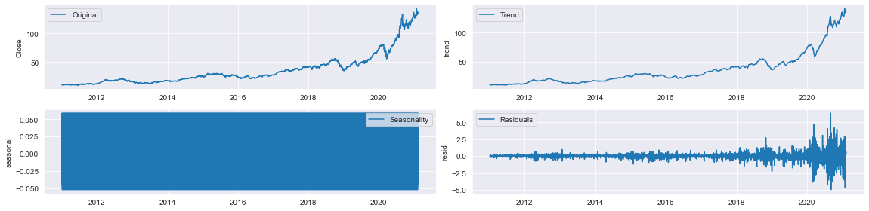
Data Preparation

Slide 6
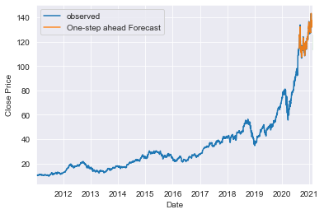
Modeling
SARIMAX Model with exogenous features

Slide 7
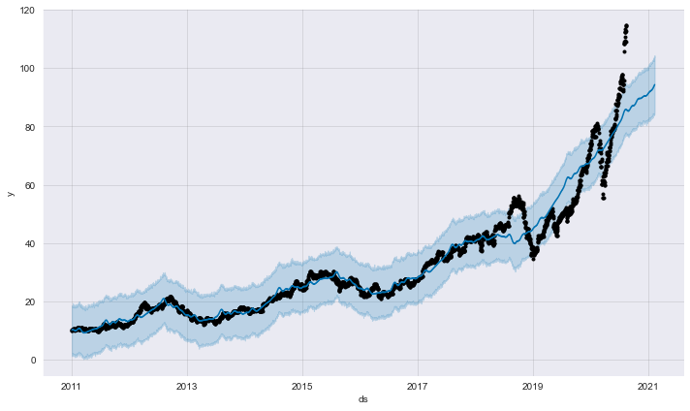
Modeling
Facebook Prophet

Slide 8
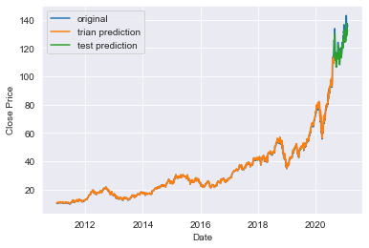
Modeling
LSTM

Slide 9

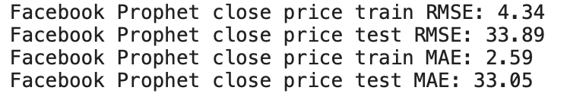
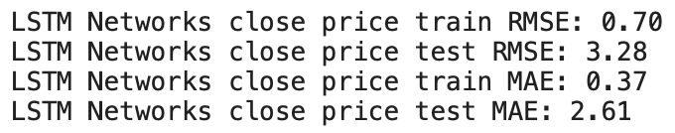
Evaluation

